Slide 1
Query Processing

Slide 2
Evaluating Relational Operators

Slide 3
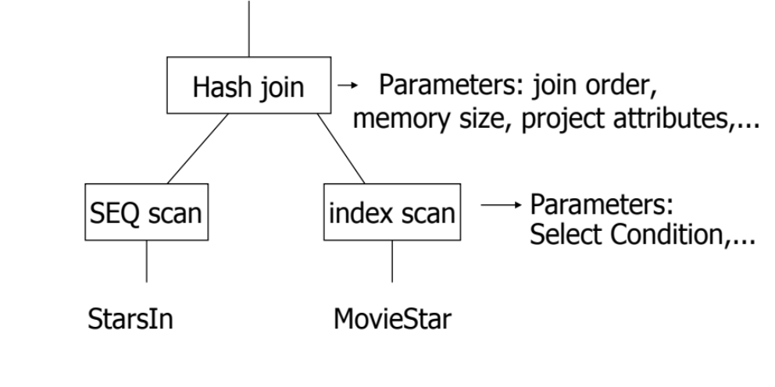
Top-Down vs. Bottom-Up Evaluation
Projection
Project the “attributes”
Most DBMSs apply the Top-Down Evaluation
Top-Down Evaluation
  The top operator requests a tuple from the operator below it (Recursive)
  Tuples flow only when requested (pull-based)
Bottom-Up Evaluation
  The bottom operators push their tuples upward
  Tuples flow when ready (push-based)

Slide 4
Common Techniques For Evaluating Operators
Algorithms for evaluating relational operators use some simple ideas extensively:
Indexing
Iteration
Partitioning

Slide 5
Common Techniques For Evaluating Operators
Algorithms for evaluating relational operators use some simple ideas extensively:
Indexing: Can use WHERE conditions to retrieve small set of tuples (selections, joins)
Iteration: Sometimes, faster to scan all tuples even if there is an index. (And sometimes, we can scan the data entries in an index instead of the table itself.)
Partitioning: By using sorting or hashing, we can partition the input tuples and replace an expensive operation by similar operations on smaller inputs.

Slide 6
Another Categorization
One Pass Algorithms
  Need one pass over the input relation(s)
  Puts limitations on the size of the inputs vs. memory
Two Pass Algorithms
  Need two pass over the input relation(s)
  Puts limitations on the size of the inputs vs. memory
Multi-Pass Algorithms
  Scale to any size and may need several passes over the input relation(s)

Slide 7
Categorizing Algorithms
By Underlying Technique
  Sort-based
  Hash-based
  Index-based
By the number of times data is read from disk (Passes)
  One-pass
  Two-pass
  Multi-pass (more than 2)
By what the operators work on
  Tuple-at-a-time, unary
  Full-relation, unary
  Full-relation, binary

Slide 8
Common Statistics over Relation R
B(R): # of blocks to hold all R tuples
T(R): # tuples in R
S(R): # of bytes in each of R’s tuple
V(R, A): # distinct values of attribute A in index R.A
M: # of memory buffers available
R is “clustered” ➔ R’s tuples are packed into blocks
➔ Accessing R requires B(R) I/Os
R
R is “not clustered” ➔ R’s tuples are distributed over the blocks
➔ Accessing R requires T(R) I/Os

Slide 9
Example: Join (R,S)
One Pass
Join
S
Iteration
R
Assume S is smaller than R
For this join algorithm to work:
  S must fit in memory
  One additional buffer for R
Open():
read S into memory
GetNext():
for b in blocks of R:
for t in tuples of b:
if t matches tuple s:
return join (t,s)
return NotFound
Close():
Clean memory
Key Metrics (memory Req.):
  M >= B(S) + 1
I/O Cost:
  B(S) + B(R)
Notes:
  Can use prefetching for R

Slide 10
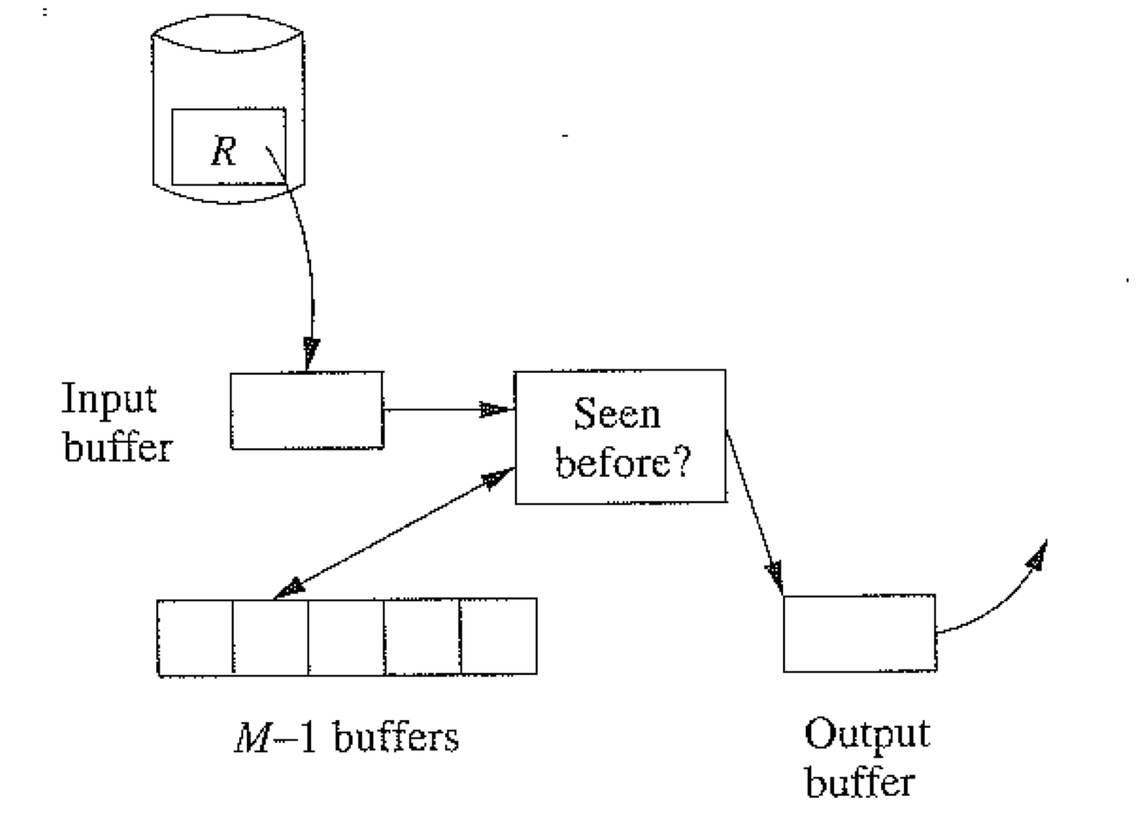

Example: Duplicate Elimination
One Pass
Distinct
Iteration
R
Keep a main memory search data structure D (use search tree or hash table) to store one copy of each tuple ➔ (M-1 Buffers)
Read in memory each block of R one at a time (use table scan) ➔ (1 buffer)
For each tuple check if it appears in D
  If Yes, then skip
  If Not, then add it to D and to the output buffer
1 memory buffer for reading
M-1 memory buffers for storing distinct copies
What are the constraints for this algorithm to work in one pass?
What is the I/O Cost
The distinct tuples of R must fit in M-1 Buffers
>> B (δ (R)) <= M-1
>> Could be approximated as B(δ (R)) <= M
  B(R)

Slide 11
Example: Duplicate Elimination
Distinct
R
What if relation R is sorted
How the duplicate elimination op. works ???
Are there any size constraints to be in one pass ???
What is the I/O cost ???

Slide 12
Example: Duplicate Elimination (Cont’d)
Distinct
R
What if relation R is sorted
How the duplicate elimination op. works ???
  No need for the M-1 Buffers (we keep only the last reported tuple)
Are there any size constraints to be in one pass ???
  No (1 memory buffer to handle R of any size)
What is the I/O cost ???
  B(R)
Each operator must know the properties of its input relations
(Sorted or not, grouped or not, …)
Makes big difference in execution and performance

Slide 13
Example: Group By
One Pass
Group By
Iteration
R
Keep a main memory search data structure D (use search tree or hash table) to store one entry for each group ➔ (M-1 Buffers)
Read in memory each block of R one at a time (use table scan) ➔ (1 buffer)
For each tuple, update its group statistics
1 memory buffer for reading
Update group statistics
M-1 memory buffers for storing one entry for each group
What are the constraints for this algorithm to work in one pass?
What is the I/O Cost
The groups must fit in M-1 buffers
Cannot be written in terms of B(R) or T(R)
Worst case: Each tuple is a group
  B(R)

Slide 14
Example: Set Union(R,S)
One Pass
Union
S
Iteration
R
Assume S is smaller than R
Read smaller relation into main memory (S) ➔ M-1 Buffers
Use main memory search structure D to allow tuples to be inserted and found quickly
Produce S’s tuples to output as you read them
Read from R one block at a time ➔ 1 Buffer
  If tuple exists in D, skip
  Otherwise, write to output
What are the constraints for this algorithm to work in one pass?
What is the I/O Cost
B(R) + B(S)
Min(B(R), B(S)) <= M-1 (or M as approximation)

Slide 15
Blocking vs. Non-Blocking Operators
Blocking operator cannot produce any tuples to the output until it processes all its inputs
Non-blocking operator can produce tuples to output without waiting until all input is consumed
For the operators we have seen so far, which one is blocking ???
  Join, union ➔ Non-blocking
  Grouping ➔ Blocking
  Others??? Selection, Projection ➔ Non-blocking
  Others??? Sorting ➔ Blocking

Slide 16
Two-Pass Algorithms

Slide 17
Two-Pass Algorithms
First Pass: Do a prep-pass and write the intermediate result back to disk
>> We count Reading + Writing
Second Pass: Read from disk and compute the final results
>> We count Reading only (if it is the final pass)
Sort-based two-pass algorithms
  The first pass does a sort on some parameter(s) of each operand
  The second pass algorithm relies on the sort results and can be pipelined
Hash-based two-pass algorithms

Slide 18
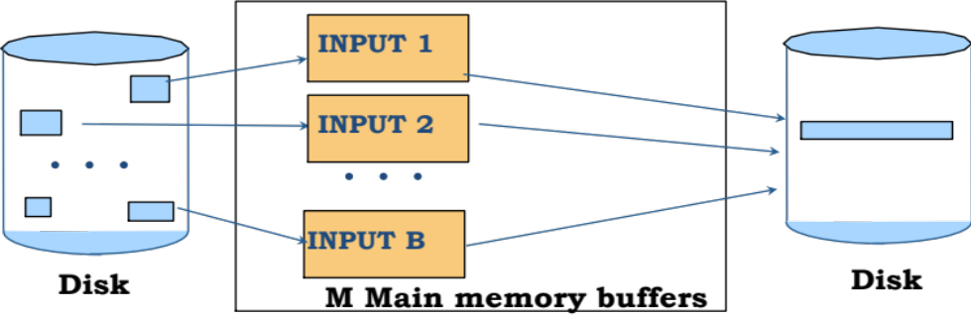
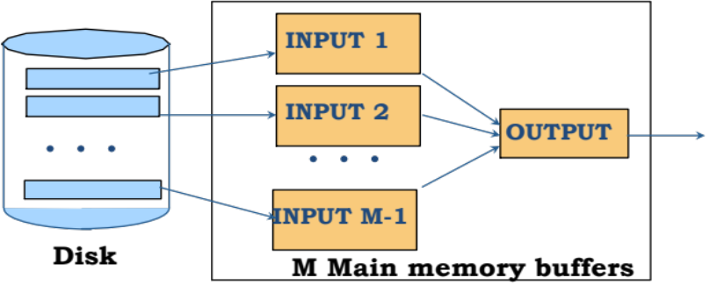
Example: 2-Pass External Sort
Sort
R
Phase 1: Read M blocks at a time, sort them, write to disk as one run
Each run is sorted of size M
(we have B(R)/M runs)
What are the constraints for this algorithm to work in one pass?
Phase 2: Merge the runs and produce the sorted output (each run must have one memory buffer)
What is the I/O Cost
B(R)/M runs

Slide 19

Example: 2-Pass External Sort
Sort
R
Phase 1: Read M blocks at a time, sort them, write to disk as one run
Each run is sorted of size M
(we have B(R)/M runs)
What are the constraints for this algorithm to work?
Phase 2: Merge the runs and produce the sorted output (each run must have one memory buffer)
Phase 1 → no constraints
Phase 2 → each run must have a memory
buffer + one for output
>> B(R)/M <= M-1
>> Approx. B(R)/M <= M
>> B(R) <= M²
B(R)/M runs

Slide 20
Example: 2-Pass External Sort
Sort
R
Phase 1: Read M blocks at a time, sort them, write to disk as one run
Each run is sorted of size M
(we have B(R)/M runs)
What is the I/O Cost
Phase 2: Merge the runs and produce the sorted output (each run must have one memory buffer)
Phase 1 → 2 x B(R) [reading & writing]
Phase 2 → B(R) [reading]
Total 3 B(R)
B(R)/M runs

Slide 21
Sort-Based Duplicate Elimination
Distinct
R
Same as sorting, except that:
  While merging in Phase 2, eliminate the duplicates and produce one copy from each group of identical tuples
Eliminate duplicates
What are the constraints for this algorithm to work in two pass?
What is the I/O Cost
Same as the sorting operator itself

Slide 22
Sort-Based Join
Join
R
S
Remember….
For one-pass join, the smaller relation must fit in memory
  B(S) <= M
What if both relations are large?

Slide 23
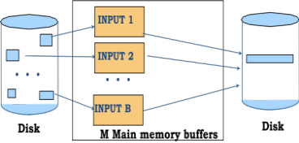
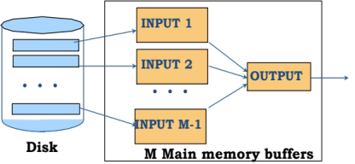
Naïve Two-Pass JOIN (Sort-Join)
Join
R
S
Sort R and S on the join key
Merge and join the sorted R and S
Step 1 (Sorting each Relation)
R
Sorted R
2-Pass Sort
S
Sorted S
2-Pass Sort

Slide 24
Naïve Two-Pass JOIN
Join
R
S
Sort R and S on the join key
Merge and join the sorted R and S
Step 2 (Merge and Join R & S)
Read one block from each relation at a time, join the tuples that exist in both relations
When one block is consumed, read the next block from its relation
Output buffer
Sorted R
Joined output
Sorted S
Memory
What are the constraints for this algorithm to work in two pass?
What is the I/O Cost

Slide 25
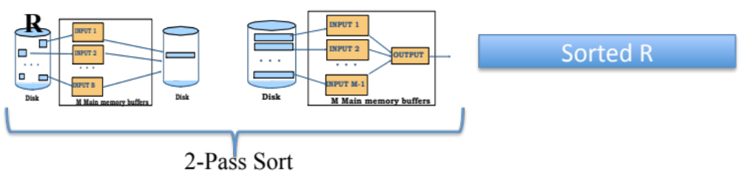
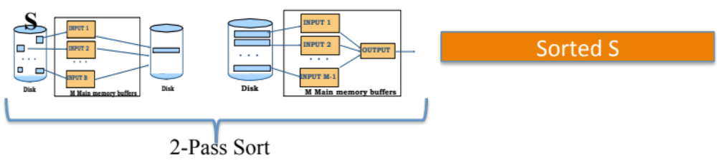
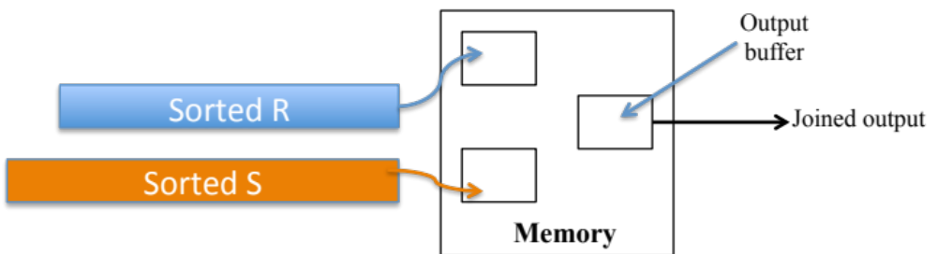
Naïve Two-Pass JOIN
Join
What is the I/O Cost
R
S
I/O Cost = 4 B(R)
Notice: we counted the output writing since it is intermediate
I/O Cost = 4 B(S)
I/O Cost = B(R) + B(S)
Total I/O Cost = 5( B(R) + B(S))

Slide 26
Naïve Two-Pass JOIN
Join
What are the constraints
R
S
>> B(R) <= M²
From the sorting algorithm
>> B(S) <= M²
No Constraints

Slide 27

Efficient Two-Pass JOIN
(Sort-Merge-Join)
Join
R
S
Main Idea: Combine Pass 2 of the Sort with the Join
Sorted runs of R ( we have B(R)/M)
Phase 2 Merge & Join
Phase 1 in Sorting As Is
One buffer for each sorted run from both R & S
One buffer for the join output
R
Output buffer
Sorted runs of S ( we have B(S)/M)
S
Memory

Slide 28
Efficient Two-Pass JOIN
(Sort-Merge-Join)
Join
S
What is the I/O Cost
R
Main Idea: Combine Pass 2 of the Sort with the Join
Sorted runs of R ( we have B(R)/M)
Phase 2 Merge & Join
Phase 1 in Sorting As Is
One buffer for each sorted run from both R & S
One buffer for the join output
R
Output buffer
2 B(R)
Sorted runs of S ( we have B(S)/M)
S
Memory
Total Cost =
3 (B(R) + B(S))
B(R) + B(S)
2 B(S)

Slide 29
Efficient Two-Pass JOIN
(Sort-Merge-Join)
Join
S
What are the constraints
R
Main Idea: Combine Pass 2 of the Sort with the Join
Sorted runs of R ( we have B(R)/M)
Phase 2 Merge & Join
Phase 1 in Sorting As Is
One buffer for each sorted run from both R & S
One buffer for the join output
R
Output buffer
No Constraints
Sorted runs of S ( we have B(S)/M)
S
Memory
Number of runs must fit in memory:
B(R)/M + B(S)/M <= M ➔ B(R) + B(S) <= M²
No Constraints

Slide 30
Two-Pass Hash-Based Algorithms

Slide 31
Hash-Based Algorithms: Main Idea
Data is too large to fit in memory
Partition the data (using hashing) into buckets
Work on each bucket individually
  Either One-Pass or Two-Pass

Slide 32
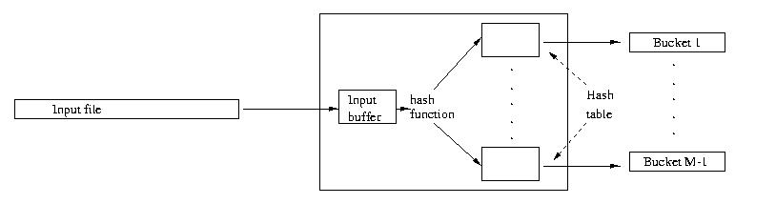
Partitioning a Relation
Read one block at a time ➔ (1 Buffer)
Keep M-1 buffers for the hash table (M-1 buckets)
Hash each tuple to its bucket’s buffer
If buffer of bucket X is full ➔ write it to disk
Good Hash function ➔ Each bucket size = B(R) / M-1
R on disk
1 buffer (block at a time)
Hash Table (M-1 Buffers)

Slide 33
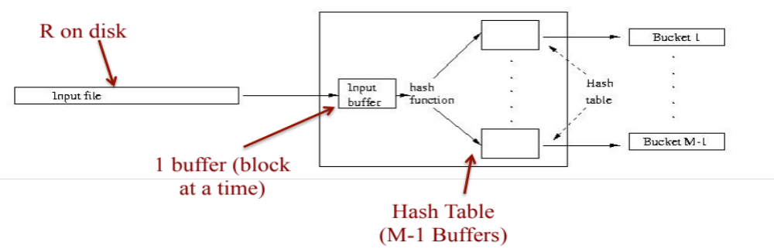
Hash-Based Two-Pass Duplicate Elimination
Distinct
R
Pass 1: Partition R using Hashing
Each bucket size = B(R) / M-1
Pass 2: Load each bucket into memory and eliminate duplicates
  Identical tuples must exist in the same bucket
What are the constraints for this algorithm to work in two pass?
What is the I/O Cost
A bucket must fit in memory
B(R)/M-1 <= M ➔ B(R) < M²
Pass 1 ➔ 2 B(R), Pass 2 ➔ B(R)
Total ➔ 3 B(R)

Slide 34
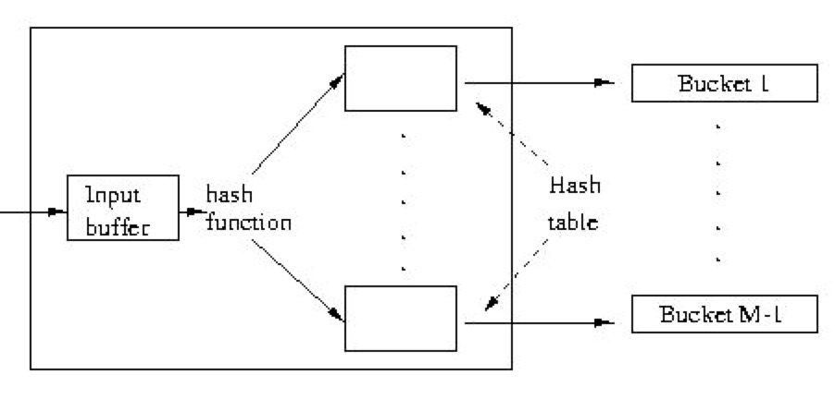
Hash-Based Two-Pass Join
Join
R
S
Phase 1: Partition each relation using the same hash function into buckets
  Hash function must be on join key
Phase 2: Join Bucket x from R with Bucket x from S
Phase 1: Partition
R
R’s buckets
S
S’s buckets

Slide 35
Hash-Based Two-Pass Join (Cont’d)
Join
R
S
Phase 2: Join Buckets R.x and S.x
Move the smaller relation’s buckets to memory ➔ (M-2) buffers
Read from the other bucket one block at a time and join ➔ 1 buffer
Build hash table or search tree for S’s buckets (M-2 buffers)
Join Result
S’s buckets
R’s buckets
Input buffer
for R’s bucket
Output
buffer
Disk
M main memory buffers
Disk
What are the constraints for this algorithm to work in two pass?
What is the I/O Cost

Slide 36
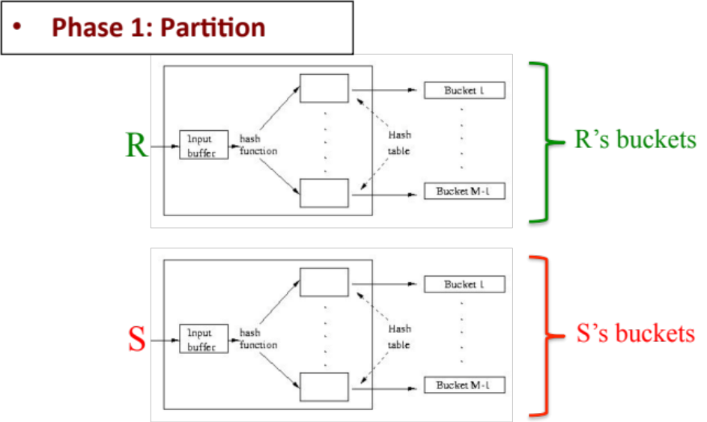
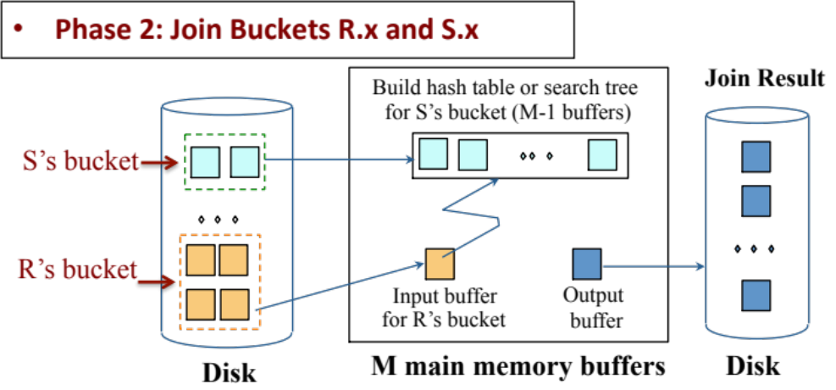
Hash-Based Two-Pass Join
Join
What is the I/O Cost
R
S
2 B(R)
Total I/O cost =
3(B(R) + B(S))
2 B(S)
B(R) + B(S)

Slide 37
Hash-Based Two-Pass Join
Join
What are the constraints?
R
S
No constraints
No constraints
Smaller bucket must fit in memory
➔ B(S)/M <= M (approximation)
B(S) <= M²
Or Min(B(R), B(S)) <= M²

Slide 38
Index-Based Evaluation

Slide 39
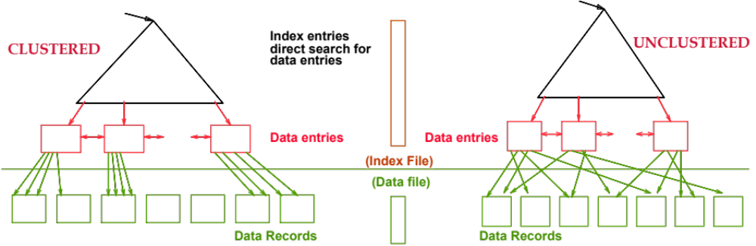
Clustered vs. Un-Clustered Index
Data records are sorted on the index key
If index returns N tuples, how many I/Os?
  N/(number of tuples per block)
➔ Number of tuples per block = T(R)/B(R)
Data records are randomly stored
If index returns N tuples, how many I/Os?
  N

Slide 40
Index-Based Algorithms
Very useful and effective for selection & join
Important property
  If read R by following its indexing pointers
    ➔ tuples will be sorted on the indexed column
  Can be used to Sorting, Duplicate Elimination, Grouping operators

Slide 41
Need to Remember…
B(R): # of blocks to hold all R tuples
T(R): # tuples in R
S(R): # of bytes in each of R’s tuple
V(R, A): # distinct values in attribute R.A
M: # of memory buffers available
R is “clustered” ➔ R’s tuples are packed into blocks
➔ Accessing R requires B(R) I/Os
R
R is “not clustered” ➔ R’s tuples are distributed over the blocks
➔ Accessing R requires T(R) I/Os

Slide 42
Index-Based Join
Join
R
S
Assume Joining R & S on column Y
What is the I/O Cost?
Assume S.Y has an index
R (the one with No index)
becomes the outer relation
S (the one with index)
becomes the inner relation
For each r ∈ R do
[ X ← index-on-S.Y-lookup(r.Y)
For each s ∈ X do
Output (r,s) pair]
Follow the pointers from the index and retrieve the data tuples X from S

Slide 43
Index-Based Join
Join
What is the I/O Cost?
R
S
Read R block at a time
  B(R) if R is clustered
  T(R) if R is not clustered
How many lookups we do?
➔ T(R)
What is the expected size of X?
➔ T(S) / V(S,Y)
(we assume uniform dist.)
For each r ∈ R do
[ X ← index-on-S.Y-lookup(r.Y)
For each s ∈ X do
Output (r,s) pair]
Translates to how many I/Os?
T(S)/ V(S,Y) if unclustered index
B(S)/V(S,Y) if clustered index
What is the index I/O cost? (Index height = H)
0 if the index in memory
H if entirely not in memory
(H-z) if the 1st z-levels of index are in memory

Slide 44
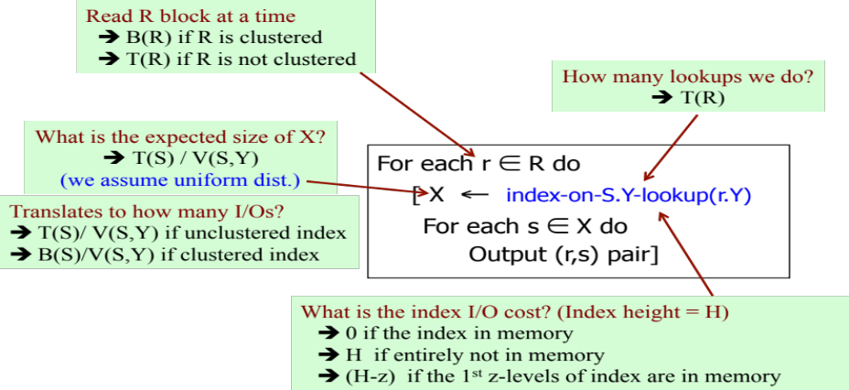
Index-Based Join
Join
What is the I/O Cost?
R
S
Assume R is clustered, S.Y index in memory, and the index is clustered….What is the cost?
➔ B(R) + T(R) (B(S)/ V(S,Y))
Assume R is un-clustered, S.Y height = 3, the root is in memory, and the index is clustered….What is the cost?
➔ T(R) + T(R) (2 + B(S)/ V(S,Y))

Slide 45
Block Nested-Loop Join

Slide 46
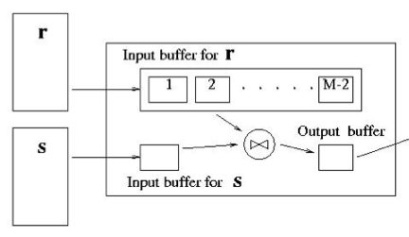
Block Nested-Loop Join
Join
R
S
Sometimes other techniques do not help
Examples:
  Join based on R.x <> S.x
  Join based on R.x = F(S.x), F is black-box func.
S
S
M-1
R
R
If the smaller relation fits in memory
Use “One-Pass Iteration Join” covered before
If not…
Allocate M-1 buffers for the smaller relation S (outer relation)
For each (M-1) blocks from S
  Use 1 buffer to scan R (inner relation) one block at a time, and join with the M-1 blocks of S
Repeat with the next (M-1) blocks of S until all is done.

Slide 47
Block Nested-Loop Join
Join
R
S
Sometimes other techniques do not help
Examples:
  Join based on R.x <> S.x
  Join based on R.x = F(S.x), F is black-box function
Exercise: Compute the cost if R is the outer relation??
What is the I/O Cost?
S will be read once ➔ B(S)
For each M-1 blocks from S, R is read once
➔ (B(S)/M-1) x B(R)
Total = B(S) + (B(S)/M-1) x B(R)
If the smaller relation fits in memory
Use “One-Pass Iteration Join” covered before
If not…
Allocate M-1 buffers for the smaller relation S (outer relation)
For each (M-1) blocks from S
  Use 1 buffer to scan R (inner relation) one block at a time, and join with the M-1 blocks of S
Repeat with the next (M-1) blocks of S until all is done.

Slide 48
Covered So Far…
One-Pass Operator Evaluation
  Join, Duplicate Elimination, Group By, Set Union
Two-Pass Evaluation (Sort-Based)
  Sort, Duplicate Elimination, Join [Sort-Join, Sort-Merge-Join]
Two-Pass Evaluation (Hash-Based)
  Duplicate Elimination, Join
Index-Based Evaluation
  Join
Nest-Loop Join

